Slide 1

SPEECH RECOGNITION
- Rajalakshmi Santhakumar
DS-SEA 08

Slide 2
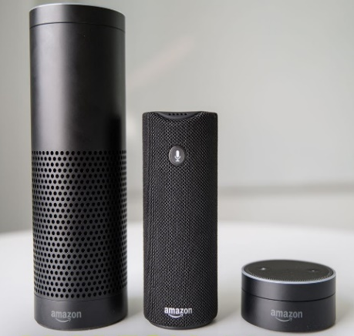
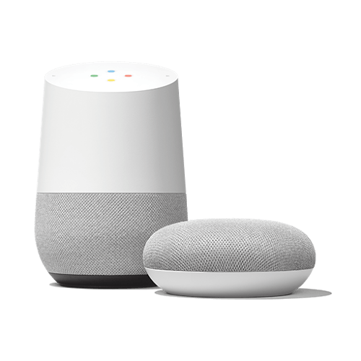

THE PROBLEM STATEMENT
Automatic speech recognition, i.e. translating of speech into text, is still a challenging task due to the high variations in the speech signals with respect to:
Accent
Modulation and
Background noises.
Project question:
Can we build a model that can transcribe, with accuracy, the spoken words (in English) to text?

Slide 3
WHERE IS THE DATA?
Google Speech Commands Dataset
Contains a set of one-second .wav audio files, each containing a single spoken English word, collected by crowd sourcing - no details were recorded for any of the participants
Twenty core command words were recorded, with most speakers saying each of them five times
The core words are "Yes", "No", "Up", "Down", "Left", "Right", "On", "Off", "Stop", "Go", "Zero", "One", "Two", "Three", "Four", "Five", "Six", "Seven", "Eight", and "Nine".
To help distinguish unrecognized words, there are also ten auxiliary words, which most speakers only said once
These include "Bed", "Bird", "Cat", "Dog", "Happy", "House", "Marvin", "Sheila", "Tree", and "Wow".

Slide 4
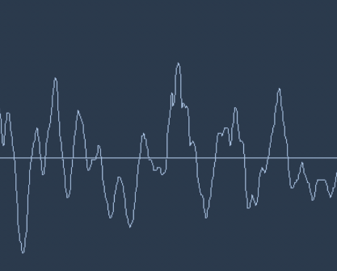
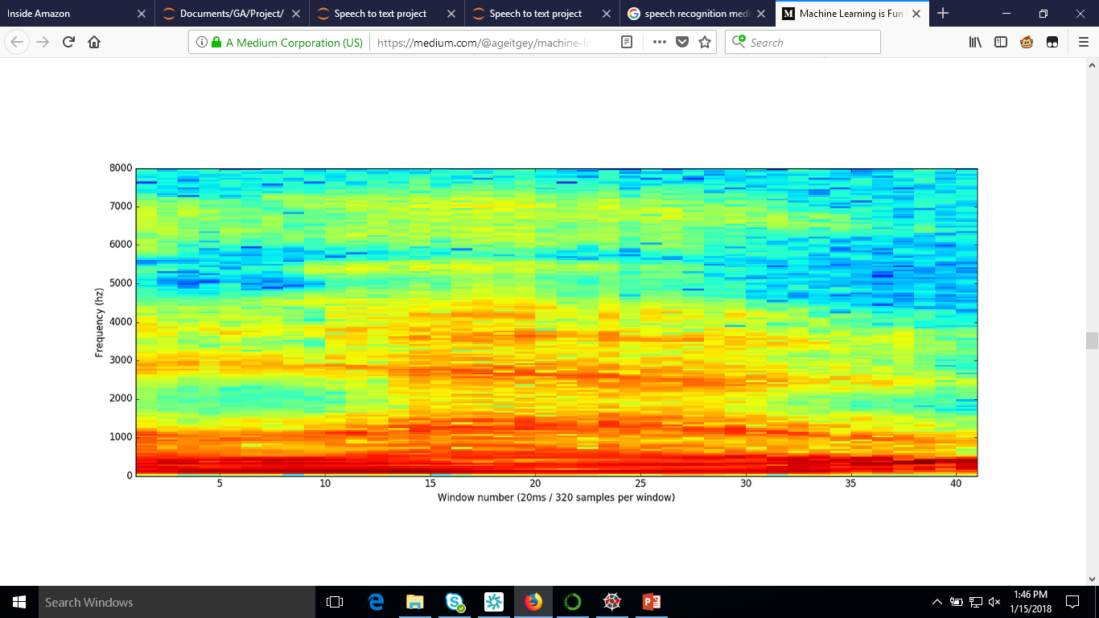
DATA EXTRACTION AND PRE-PROCESSING
Sound is transmitted as waves – one dimensional (i.e. At every moment in time, they have a single value based on the height of the wave)
‘scipy.io.wavfile.read’ – provides an array of numbers with each number representing the sound wave’s amplitude at 1/16,000th of a second intervals.
‘fft’ – provides a score that represents how much energy was in each 50hz band of our audio clip
Sampling
Fourier
Transform

Slide 5
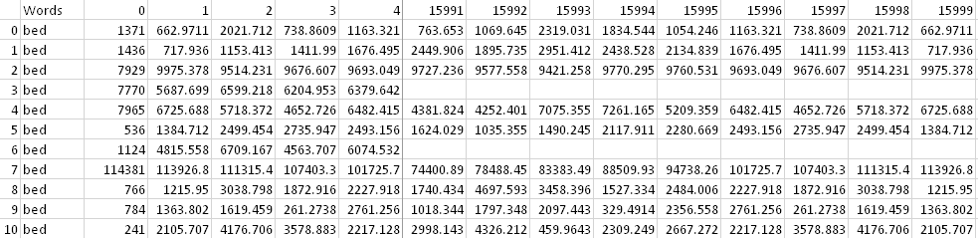
DATA EXTRACTION AND PRE-PROCESSING
20 core words – 2375 files; 10 auxiliary words – 1735 files
Each audio file, after sampling and Fourier transformation, generates 16,000 records which corresponds to the energy in each 50hz band which is stored as a numpy array.
This numpy array is sequentially appended to a Data Frame and finally is written to an output file in csv format.

Slide 6
NEXT STEPS
Impute missing values
Develop a model that best predicts the word
Tensorflow
Neural network models
Validate the model using the validation data
Possible limitations of the current model:
The current model would be build based on the 30 words in the dataset
The extrapolation of the model to the other words and real-life ASR (Automatic Speech recognition) models is not possible due to the limited data

Slide 7

THANK YOU!!!!
Questions?

